Slide 1

Facial Expression Recognition
By: Zane Hirning

Slide 2
Introduction
Automated Facial Expression Recognition
Graph Based Texture Transformation

Slide 3
Current Techniques For Facial Expression Classification
Feature Extraction
Local Binary Pattern
Gabor Wavelets
Local Directional Number Pattern
Deep Learning
Convolutional Neural Networks
Image Processing Methods
Local Descriptors
Facial Landmark Detection
Many More

Slide 4
Approach Steps
Image Preprocessing
Face Area is segmented and resized
Segmented image is divided into pieces
Proposed Texture Transformation is applied for feature extraction
Extracted Features are concatenated together to form feature images
PCA and one dimensional maximum pooling are used for feature reduction
SVM or LDA are used for classification

Slide 5
Face Area Segmentation and Resizing
Paper’s Approach
My Approach
Because the face was always placed in the same spot – I could use this information to segment the face
Once I found where the face would lay, I removed unnecessary pixels
Image was then resized to 128x128 pixels
Manually segment the image
Manually resize the image

Slide 6
Segmented Image is Divided Into Pieces
Paper’s approach was to divide this image into 30 x 30 non-overlapping blocks
I utilized many different image divisions – including 20 x 20, 10 x 10, and 4 x 4
I ended up going with the 4 x 4 because it yielded the best results in the training phase when compared to computation time (change later)
This also made the later stages easier

Slide 7
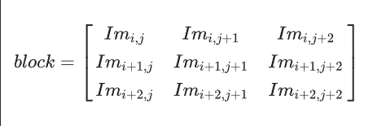
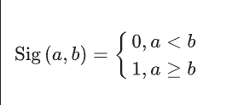
The Proposed Texture Based Transformation
Utilized a five level graph-based transformation
Signum function
3 x 3, 5 x 5, and 7 x 7 blocks were used
Example 3 x 3 block and Signum Function:

Slide 8
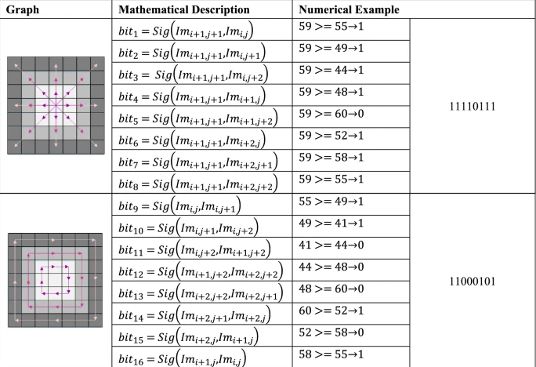
Level One Graph Based Transformation
Signum function is utilized, a is the pixel you are “on”, b is the one that is being compared
2 Graphs are utilized
16 bits are extracted

Slide 9
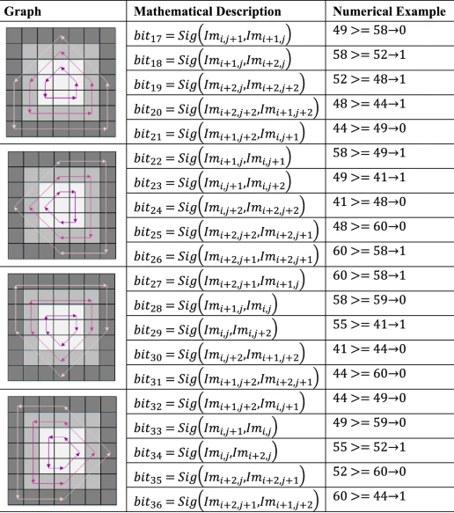
Level Two Graph Based Transformation
4 graphs are utilized
All graphs are derived from the first (pattern is similar)
20 bits are extracted
At this point, 36 bits have been extracted

Slide 10
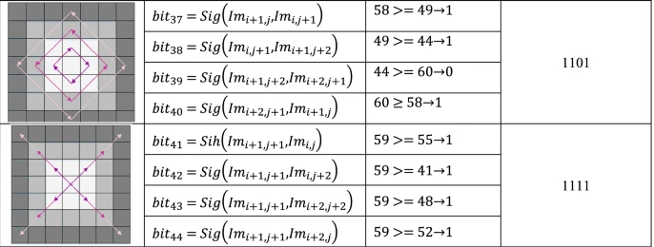
Level Three Graph Based Transformation
Two graphs are utilized
8 bits are extracted
Two distinct graphs
At this point, 44 bits have been extracted.

Slide 11
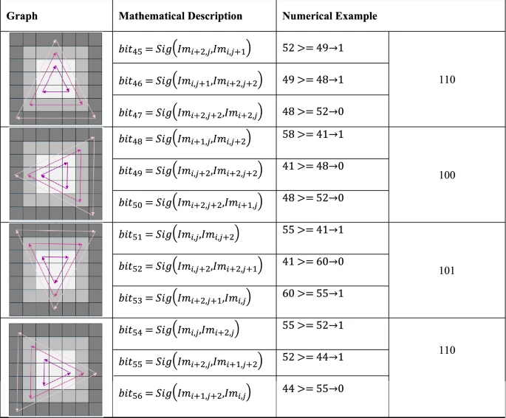
Level Four Graph Based Transformation
4 graphs are utilized
All graphs are derived from the first (pattern is similar)
12 bits are extracted
At this point, 56 bits have been extracted

Slide 12
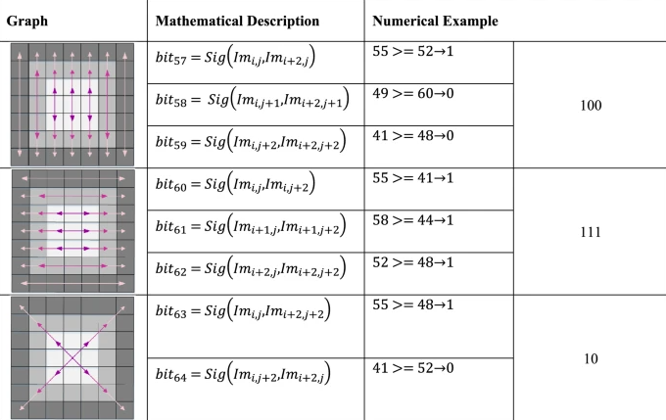
Level Five Graph Based Transformation
Three graphs are utilized
Graphs are all in different line patterns
8 bits of data are extracted
Finally, 64 bits have been extracted at this point

Slide 13
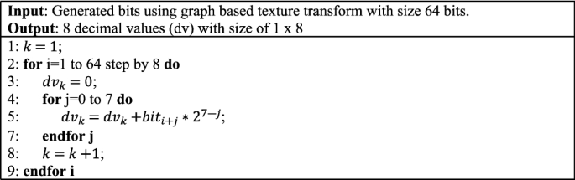
Extracted Feature Concatenation
64 bits have been extracted at this point
The bits from each level are concatenated together and are used for feature image construction
These 64 bits are utilized to create 8 feature images
The histogram of each of these images are used as features

Slide 14
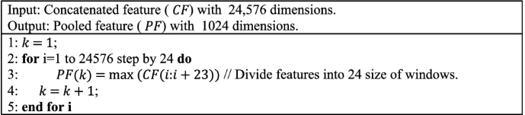
1D Maximum Pooling
The feature images from each block of the division image is combined
1D maximum pooling is applied
1D maximum pooling cuts down the features from 24,576 to 1,024
These numbers are dependent on the implementation

Slide 15
PCA
In this step, a PCA is applied
The PCA is applied onto the pooled features from the previous step (1D Maximum Pooling)
This will cut down the features from 1,024 features to 128 (also dependent on implementation)

Slide 16
SVM and LDA Classifiers
Finally, the features that have been collected from this process are used for training, validating, and testing the model
The approach does not do anything special, nor does it mention any specific hyperparameters for the model.
The evaluation metric used was accuracy
In the paper, they utilized both SVM and LDA classifiers
I only utilized an SVM classifier

Slide 17
Shortcomings
Computational Complexity
Interpretability
Dependency on graph structure

Slide 18

Improvements
No overall improvements

Slide 19

Experimental Results
The highest test score I could achieve was around 50%
This obviously pales in comparison to what they had achieved

